Slide 1
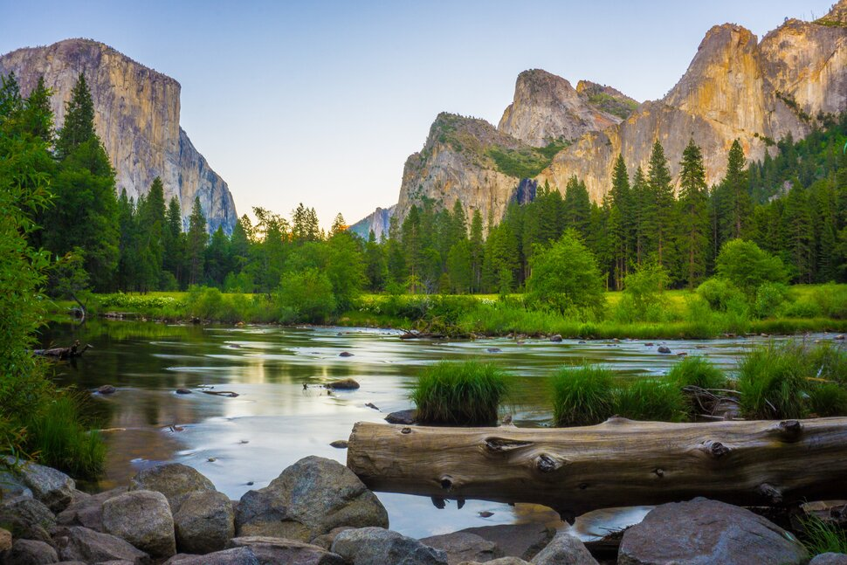
US National Parks Data Analysis
By: Cody Osieczonek, Andrea Monnerie, Tyler White, and Mason Godlove

Slide 2
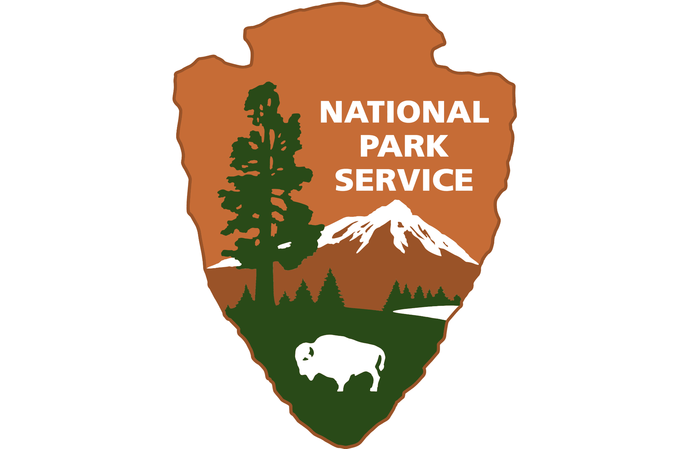
Source: National Park API
Link to website: https://www.nps.gov/subjects/developer/index.htm
Link to the API document: https://www.nps.gov/subjects/developer/api-documentation.htm
Data used to translate 4-Letter park codes to the full park names using NP_dict.ipynb:
https://www.nps.gov/aboutus/foia/upload/NPS-Unit-List.xlsx
Base API URL: developer.nps.gov/api/v1
“This API is designed to provide authoritative National Park Service (NPS) data and content about parks and their facilities, events, news, alerts, and more.” (quote from https://www.nps.gov/subjects/developer/api-documentation.htm).

Slide 3
Overall Project’s Objectives
We analyzed national parks data to provide tourists with adequate, specific, and unique insights to help plan visits to the National Parks. Depending on the tourists preference for camping, amenities, activities and events, there is data that is suitable to customize their own unique experience.
Each member of our team will show you how collected data on campsites, amenities, activities, and events to help make the decision making process easier for tourist.
At the end we will provide our conclusion, summary statistics, and recommendations.

Slide 4
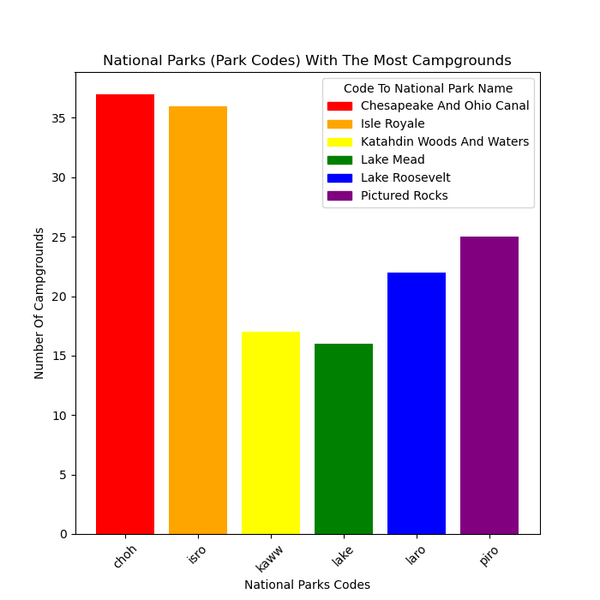
Campground Data
Our first objective was to determine which national parks have the most campgrounds per park.
Chesapeake and Ohio Canal National Park had the most campgrounds with 37 in the park.
Lake Mead had the least amount of campgrounds with 15 sites in park.
To make it easy for the tourist to prioritize camping we excluded national parks with less than 15 campsites. (A total of 117 had at least 1 but less than 15).

Slide 5
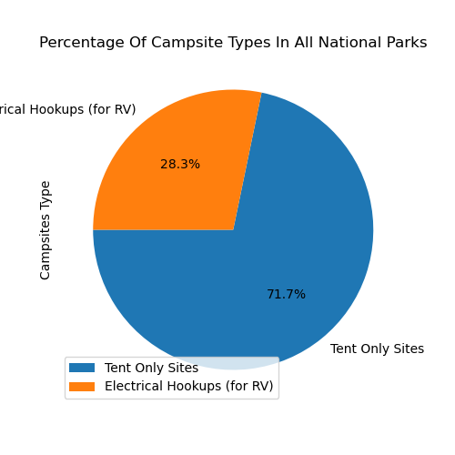
Campground Data Cont.
The second objective was to give tourists a big picture of what to expect when traveling to national parks all over the nation by providing them with appropriate statistics.
The pie graph shows the ratio of tent only sites to RV sites with electrical hookups.
Tent sites make up 71.7% of all sites across all national parks while RV sites with electrical hookups make up only 28.3%

Slide 6
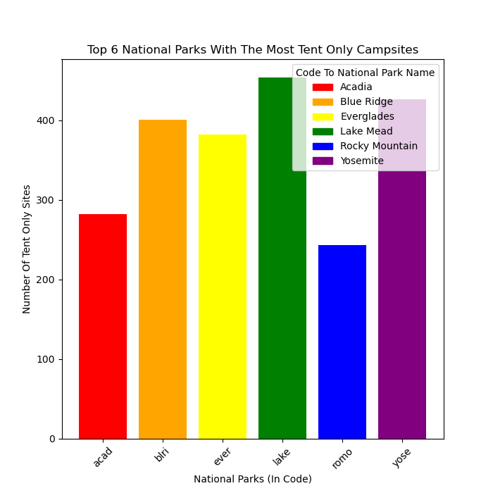
Campground Data Cont.
The third objective was to determine which national parks have the most tent only sites for tourists that prefer this option.
Tourists have the most options with Lake Mead having more than 400 sites.
Yosemite and Blue Ridge also offered 400 or more.
Rocky Mountain National Park came in with least amount of options with approximately 250.

Slide 7
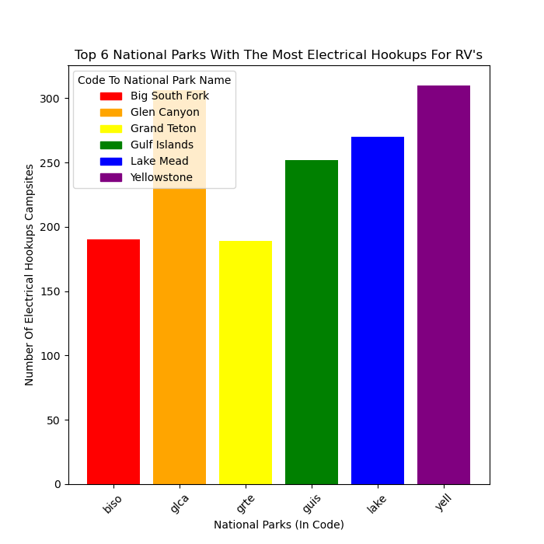
Campground Data Cont.
The fourth objective was to determine which national parks offered more electrical hookups for RV’s to allow tourists to prioritize this if necessary for their experience.
Yellowstone offered the most with about 310 and Glen Canyon in a close second with about 306.
Big South Fork and Grand Teton tied for the lowest with approximately 190.

Slide 8
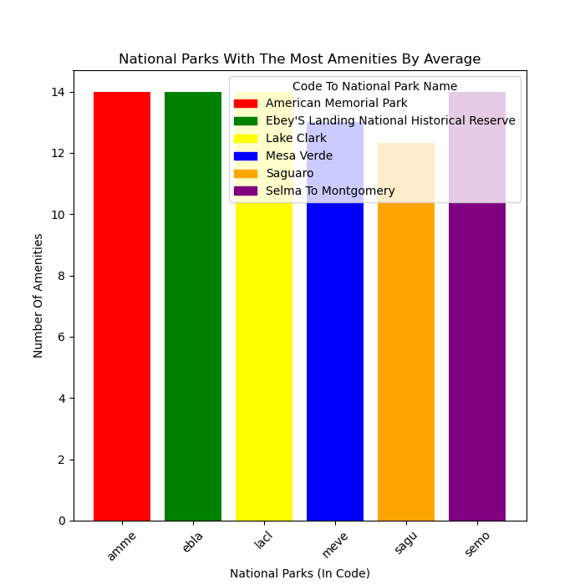
Amenities Data
The fifth objective was to find out which national parks had the most amenities in the campgrounds on average.
This information could be useful for first time travelers or travelers with children
The national parks which had the most amenities on average were American Memorial Park, Ebey’s Landing National Historical Reserve, Selma to Montgomery National Park and Lake Clark National Park with 14 total amenities each.
The runner up was Mesa Verde National Park with 13 amenities

Slide 9
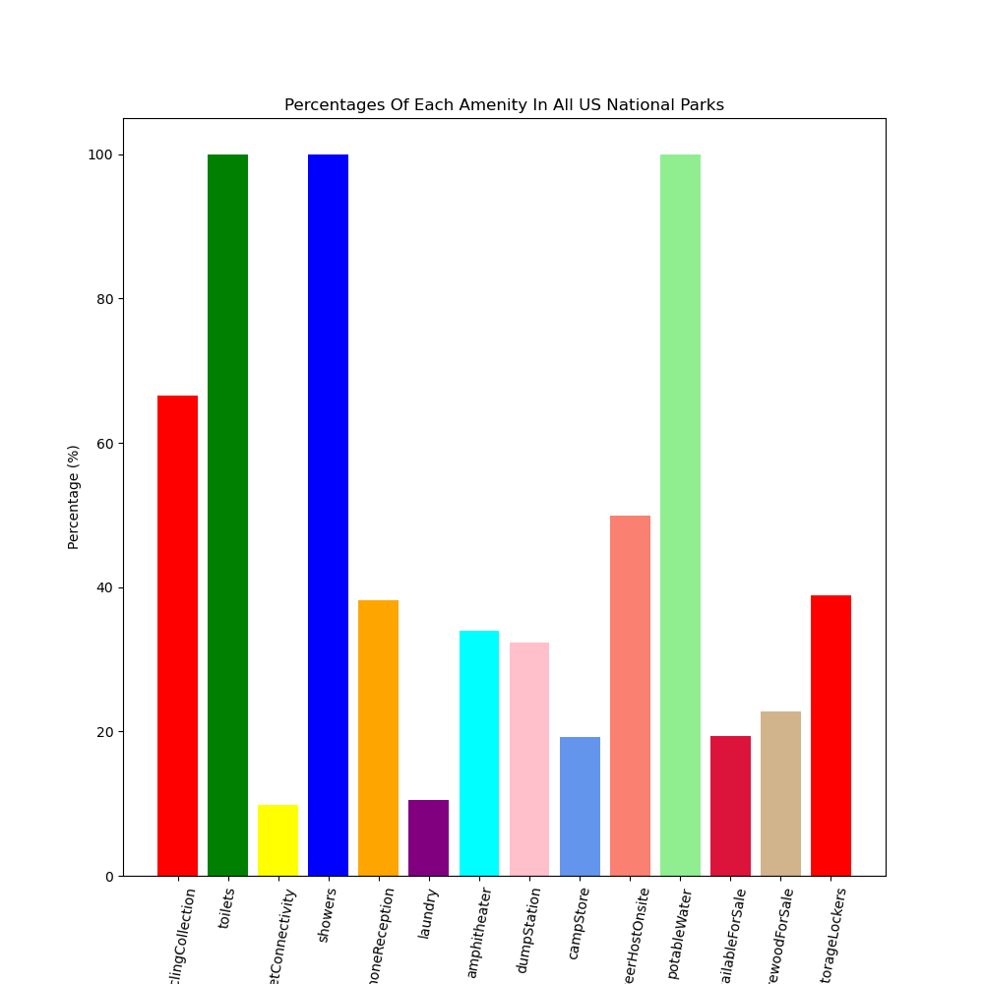
Amenities Data Cont.
We next found out the percentages of each amenity in all national parks.
100% of national parks have the following amenities: toilet (vault or compost), potable water, and showers.
We suppose there are federal laws for this
The least common amenity is internet connectivity at 9.8%
The runner up for the least common amenity is laundry at 10.7%.
Interest point: ~66% of campgrounds have trash/recycling collection.

Slide 10
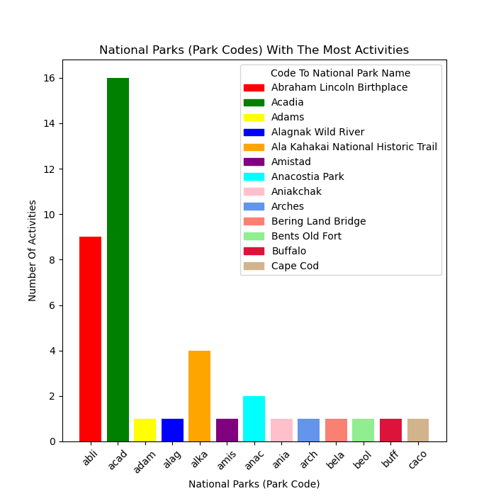
Activities Data
We next found out the national parks with most activities (biking, hiking, swimming, ect.).
This information could be useful for travelers with children or someone who wants more entertainment in parks.
The national park with the most activities was Acadia National Park with 16 total activities.
The runner-up is Abraham Lincoln Birthplace Historical Park with 9 total activities

Slide 11
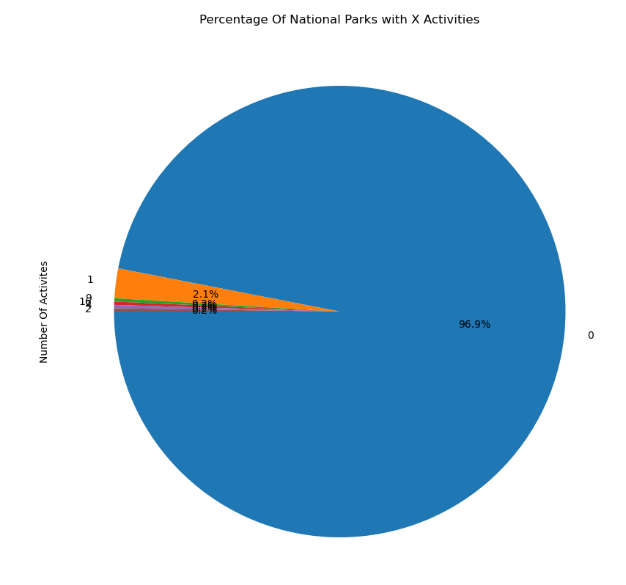
Activities Data Cont.
Mean: 3.07
Median: 1.0
Mean ≠ median, there is skewness
Mean > median, right skewness
96.9% of national parks have 0 activities
3.1% (40 parks) national parks have at least 1 activity
There are a few national parks with activities, so travelers that want activities have a few parks to choose from

Slide 12
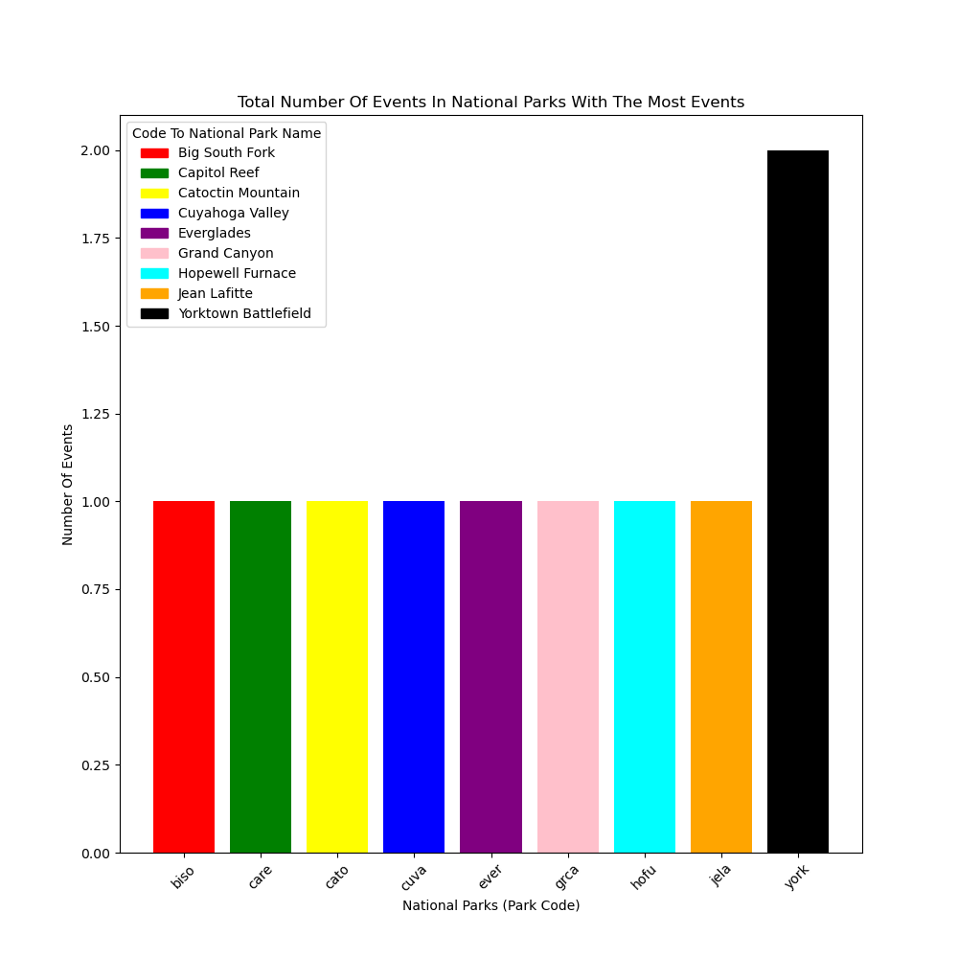
Events Data
We next found out the total number of events in national parks with the most events such as tours, walks, rides, etc.
This is our most dynamic set of data (keeps changing).
This information would be great for travelers with children or for anyone who loves history and/or nature
At the moment:
The national park with the most events was Yorktown Battlefield National Park with 2 events

Slide 13
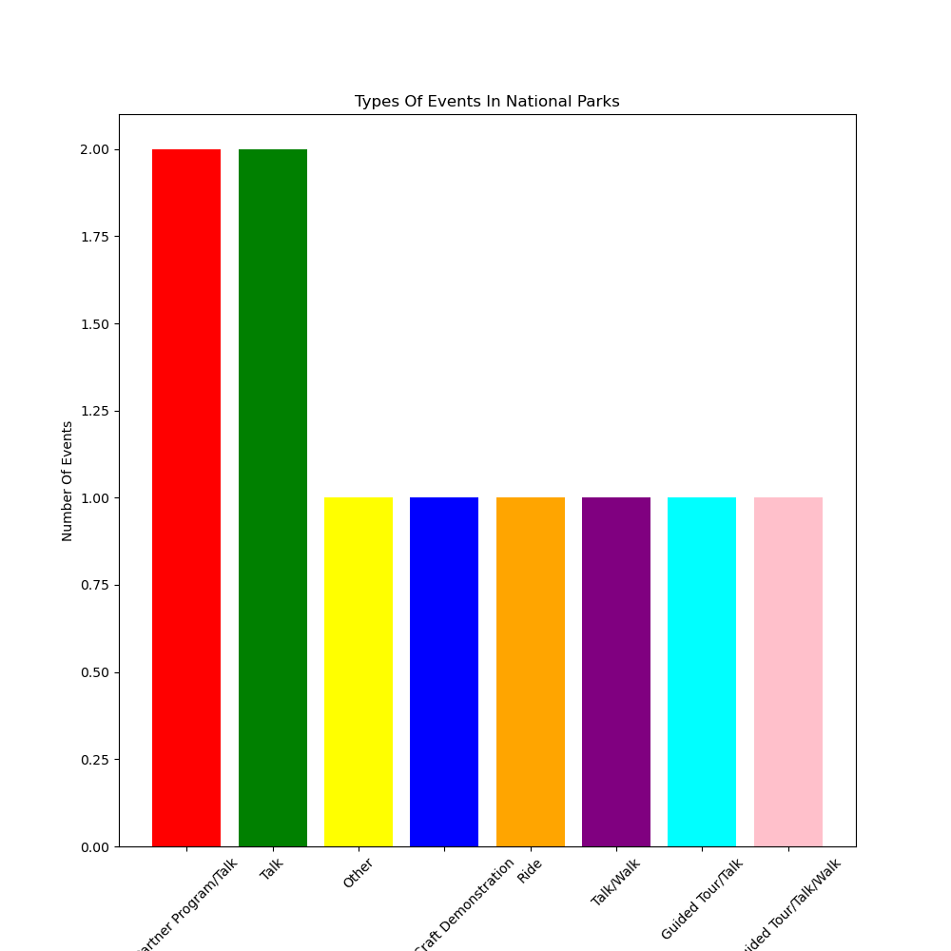
Events Data Cont.
We next found out the most common events in national parks which was talks (as well as walks/guided tours).
The runner-up is hard to say because there are several and they change constantly
Difficult to plan in advance (especially for specific events)
Very few parks (total of 7) have events
Usually parks with a well-known special attraction have events (such as unique nature scenery, historical site, culture significance)

Slide 14
Conclusion
National parks with more amenities (in campgrounds), more activities, and/or more events would be preferable for travelers with children or foreigners
Each traveler will each have specific/unique needs and wants to a trip to a national park.
Camping trip? Day trip? Three day hiking trip?
There is a national park for everyone and for every type of traveler.

